Slide 1
Spectroscopy Concept SNU AO2 Class of 2019 @ SNU-SAO 1-m, LISA with Kepler CCD
2019-10-22
Yoonsoo P. Bach

Slide 2
Spectroscopic Raw Data
Types:
object
bias
dark
flat
comparison
In photometry:
rawflat = flat + bias + dark [+ noise]
flat = rawflat – bias – dark
object = source * flat + bias + dark [+ noise]
source = (object – bias – dark) / flat

Slide 3
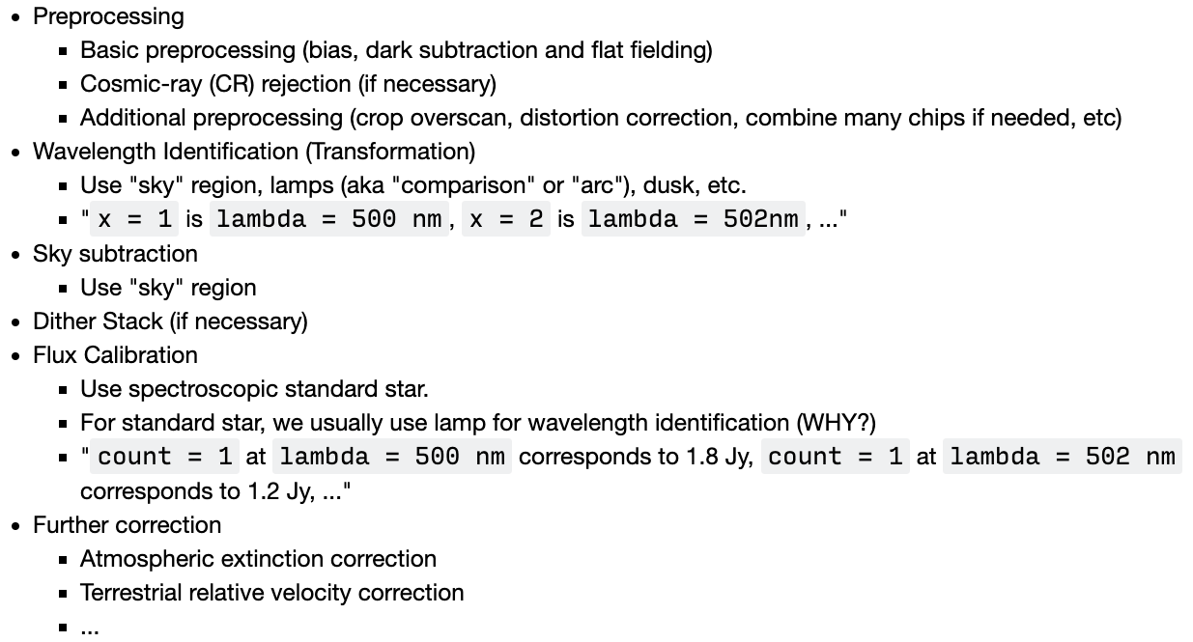
Overview
In spectroscopy we basically do

Slide 4
(Markdown code)
## Overview
In spectroscopy, basically we do
* Preprocessing
* Basic preprocessing (bias, dark subtraction and flat fielding)
* Cosmic-ray (CR) rejection (if necessary)
* Additional preprocessing (crop overscan, distortion correction, combine many chips if needed, etc)
* Wavelength Identification (Transformation)
* Use "sky" region, lamps (aka "comparison" or "arc"), dusk, etc.
* "``x = 1`` is ``lambda = 500 nm``, ``x = 2`` is ``lambda = 502nm``, ..."
* Sky subtraction
* Use "sky" region
* Dither Stack (if necessary)
* Flux Calibration
* Use spectroscopic standard star.
* For standard star, we usually use lamp for wavelength identification (WHY?)
* "``count = 1`` at ``lambda = 500 nm`` corresponds to 1.8 Jy, ``count = 1`` at ``lambda = 502 nm`` corresponds to 1.2 Jy, ..."
* Further correction
* Atmospheric extinction correction
* Terrestrial relative velocity correction
* ...

Slide 5
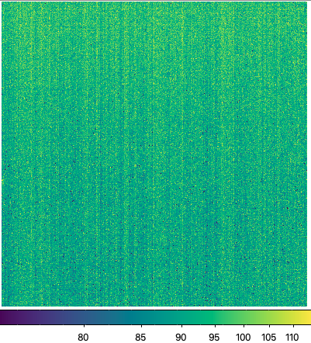
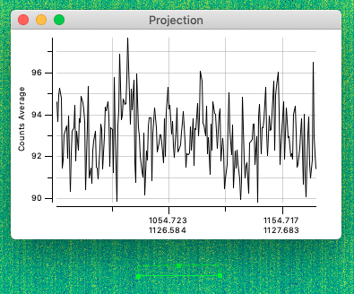
Bias and Dark
Bias / Dark = identical to photometry (Dark Frame)
Bias vertical pattern: +- 2 ADU level.
Found to be constant over the images.
Likely related to instrumental defect than external noise.
Assume the 2-D bias pattern is constant over the observation.
Bias, 2019-10-15, SNU AO2 @ SNU-SAO 1m

Slide 6
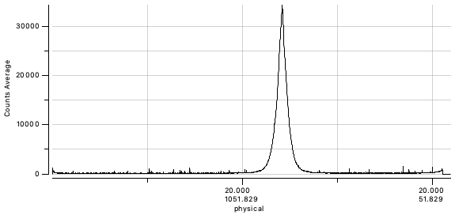
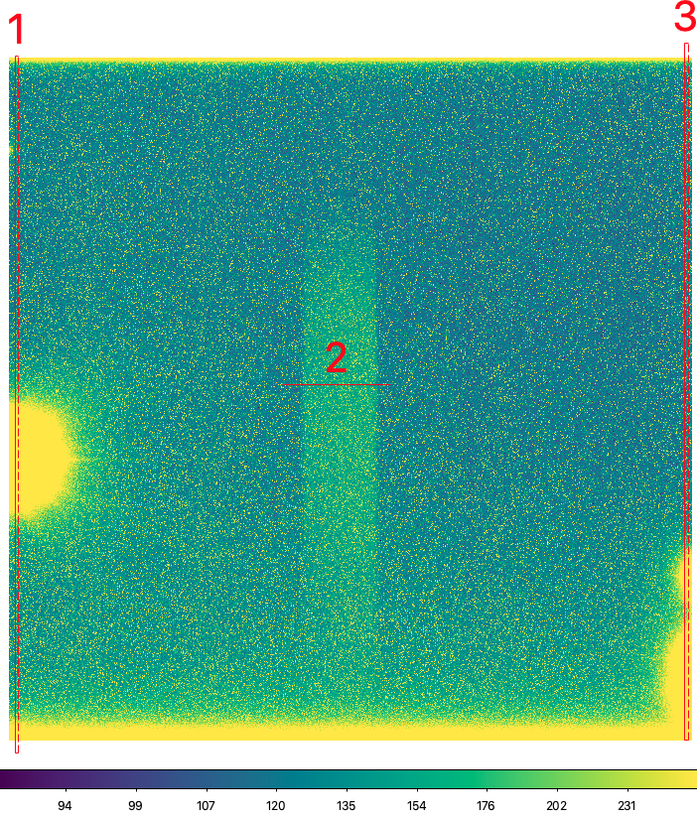
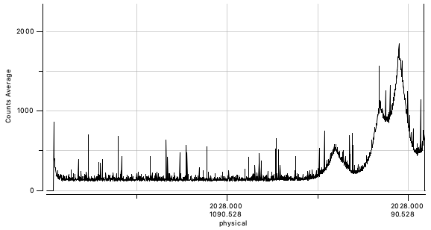
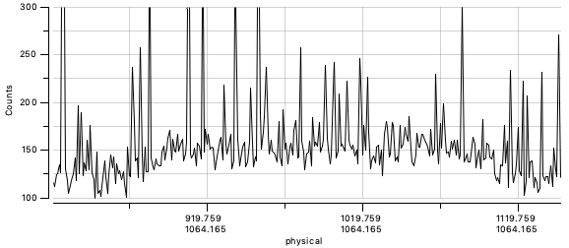
Bias and Dark
Ampglow (amplifier glow): 1, 3
While the A/D converter converts voltage to ADU, the converter can emit light which produces signal. The ampglow pattern is CCD specific. You don't need to care this because the meaningful spectrum will be at the central part of the CCD.
Afterimage: 2
There is a clear "afterimage" with additional <~ 50 ADU signal. This happens because the readout of the electrons are not perfect.
This decreases as time goes, but there is no way to avoid this.
These two are things you cannot solve.
Bias / Dark = identical to photometry (Dark Frame)
bright spots: hot pixels
30000
20000
10000
0
1
afterimage
2000
1000
0
http://darkerview.com/CCDProblems/ampglow.php
ampglow
3
ampglow
300
200
100
2
Dark 120s, 2019-10-15, SNU AO2 @ SNU-SAO 1m

Slide 7
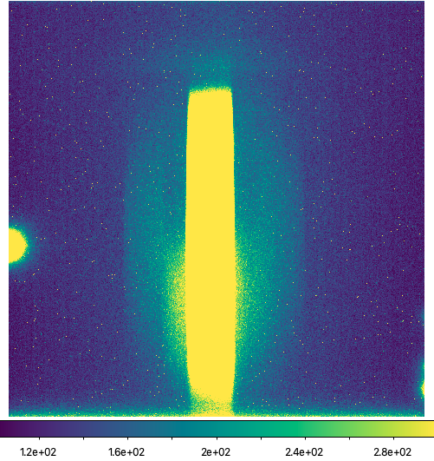
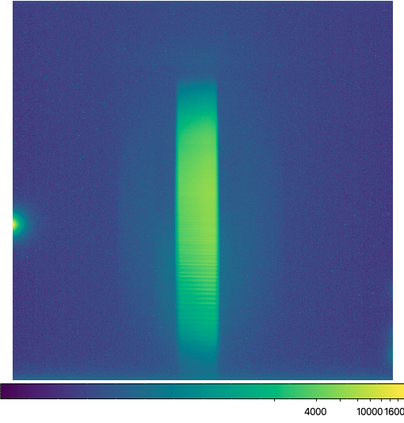
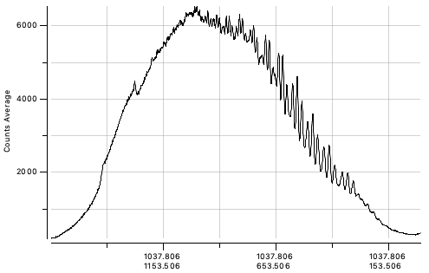
Flat
Fringe:
There are ~ +- 100–300 ADU fluctuation at longer wavelength. This is due to the interference of the transmitted light passed the CCD cover glass and the double reflected lights in the glass, as far as I understand.
You cannot solve this either.
Flat = spectroscopically flat lamp (Light Frame)
Scattered light halo:
You can see some scattered light on CCD where there should be no light incident to. This is due to the internal scattering of lights inside the instrument (and/or external light leak, which is unlikely compared to longer dark frame)
scattered light halo
See the reference by Peter Schlatter:
http://www.astrosurf.com/aras/fringing/schlatter/ripple.htm
ampglow
ampglow
ampglow
fringe
Dark 120s, 2019-10-15, SNU AO2 @ SNU-SAO 1m

Slide 8
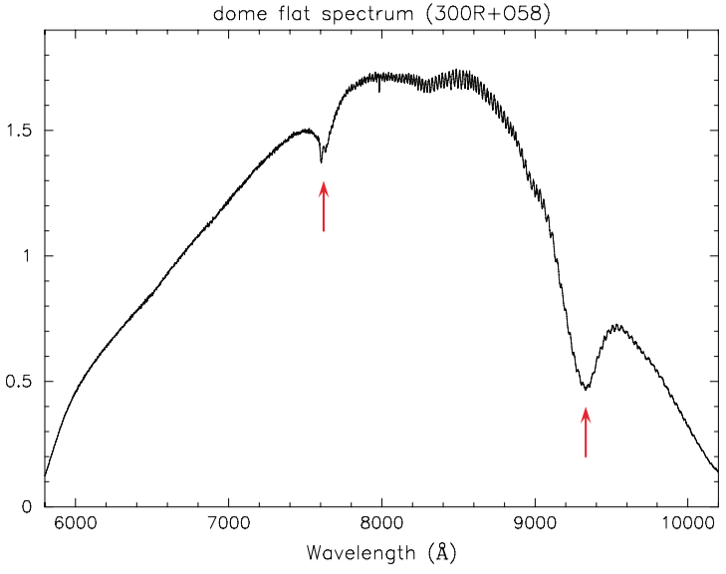
Flat
Note on flat
Think photometric flat. It should have (1) uniform flux at any spatial position, (2) high enough count ~ 20k
(1) Similarly, we expect that incident flux = const along the spatial direction in spectroscopic flat.
(2) To get such high count at all wavelength in one single exposure, the SED of the lamp must be ~ flat.
It's like, you are getting B-V-R-I flats at each wavelength bin, but with finer spectral resolution (R ≫ 10¹⁻²).
ideal case
real case
FOCAS Cookbook 1.0.3E

Slide 9
Flat
Note on fringe
If the fringe pattern is universal on all images, it doesn't actually matter.
If it differ from image to image, that's a huge problem.
That actually happens some times
http://www.ls.eso.org/sci/facilities/lasilla/instruments/efosc-3p6/tests/Fringes/efosc-fringes.html
The engineers have found that this happened because the instrument is slightly modified (due to the earth gravity, the heavy elements in the telescope will change their positions in < 1mm order between the position when you took flat and that at the target observation. Change in an order of < 1mm is enough to make few pixel difference on the position of the spectrum on the CCD).
They suggested to take flat image right after you took every single object image at that pointing.

Slide 10
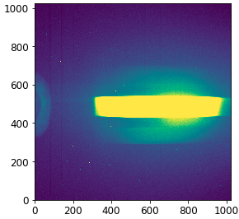
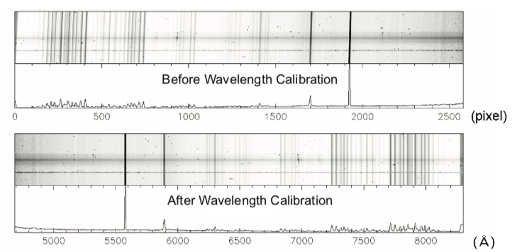
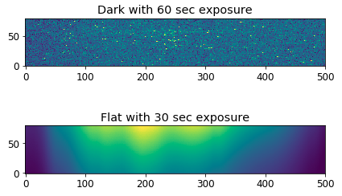
Wavelength
Consider you have preprocessed all the images.
Say x = wavelength // y = spatial
Wavelength Full Identification:
Finding fid such that
f_{id}(x, y) = λ
Note that both x, y are needed.
Using the comparison lamp (also called arc lamp) or the skylines in the object frame, we know position & λ.
Thus, find (fit) a good function fid such that f_{id}(x, y) = λ.
only this part is used
FOCAS Cookbook 1.0.3E

Slide 11
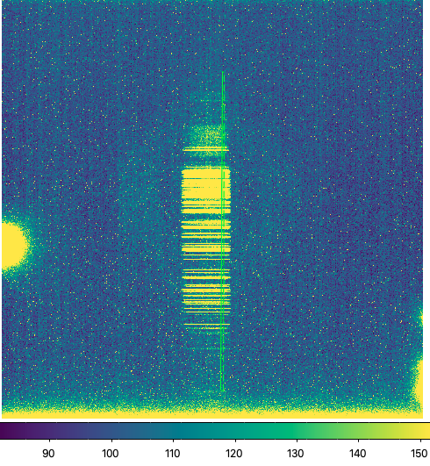
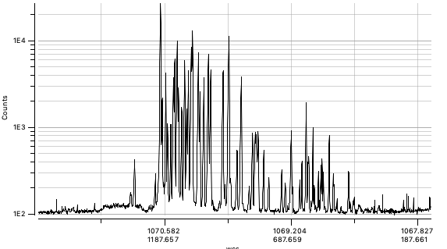
Wavelength
y
(SPATAXIS)
x
(DISPAXIS)
In practice
Cut out a region along the wavelength (dispersion) direction
Historically this direction is called the DISPAXIS and usually saved in the header.
Compare the peak of the features VS line catalog of the lamp
We used Ne lamp; see the next page
Using suitable function (e.g., Gaussian), find line center in pixel.
Fit the λ(x) function with a suitable function.
Historically this is called IDENTIFY.
People used Legendre or Chebyshev 1-D polynomial with certain degree.
Historically RMSE is used (RMSE ~ 0.2 Å is recommended from FOCAS)
Check whether it is fitted well. Otherwise, check for typos…
Do the same process for other region at different spatial position (y).
Historically this is called the REIDENTIFY
Now you have the data points (x, y, λ).
Fit the f_{id}(x, y | θ) = λ to find the parameters θ.
Historically people used Legendre or Chebyshev 2-D polynomial.
Order of 3-6 is usually enough for both directions.
Check the residuals very carefully since this will affect the final results.

Slide 12
wavelength IDENTIFY for the first spatial direction by comparing the pixel values VS line catalog

Slide 13
First IDENTIFY result (λ(x)).
RMSE ~ 0.2 Å is satisfactory for LISA at SNU-SAO.
2D REIDENTIFY result (λ(x, y)).
I used (6, 6)-degree Chebyshev 2D fit.
Δλ ~ +- 2-4 Å along the vertical (spatial) direction.
color = wavelength
+ = positions used for fitting
Note: bad extrapolation
These must be nearly linear as you saw from IDENTIFY.

Slide 14
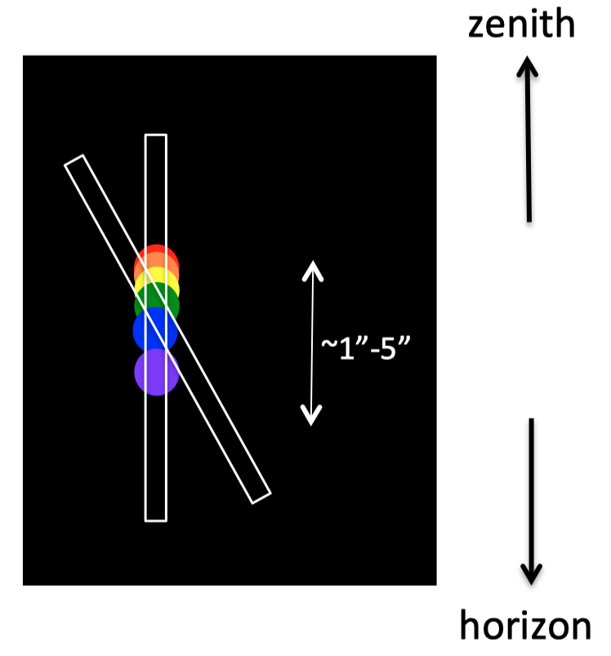
Aperture
Note that refraction disperses object.
Plus instruments are always imperfect.
Aperture trace
The trace of the object on the CCD. Finding the function f_{ap} such that
y_{center} = f_{ap}(x)
Traditionally the task to find this trace is abbreviated as APTRACE.
y
(SPATAXIS)
x
(DISPAXIS)

Slide 15
Aperture
y
(SPATAXIS)
In practice
Cut out along the spatial direction (y)
Select a certain x position where object is bright.
Fit the sky value from the pixels at different spatial positions (y values).
Historically polynomial or Legendre or Chebyshev functions were used to fit the f_{sky}(y) function.
Fit, e.g., a Gaussian, to the object to find y_{center} at that x.
Mathematically this fitting is very vulnerable to fall into local minima. Be careful about the initial conditions.
Do this for many x positions.
Now you have (x, y_{center}) data points.
Fit the f_{ap}(x | θ) = y_{center} to find the parameters θ.
Historically this is called the APTRACE.
x
(DISPAXIS)

Slide 16
y
(SPATAXIS)
Set sky region to be, e.g.,
(ycenter – 20, ycenter – 10)
& (ycenter + 10, ycenter + 20)
x
(DISPAXIS)
Initial position setting
and fit the values with Chebyshev order 3 (with sigma clipping)

Slide 17
Find APTRACE.
At each x-position, sky value is suitably subtracted. Thus, we put aperture to each x-position and sum the flux (already sky subtracted pixel values).
For each x-position, we know the wavelength, so we get instrumental SED:
ADU/s/pix (pix = Δλ)

Slide 18
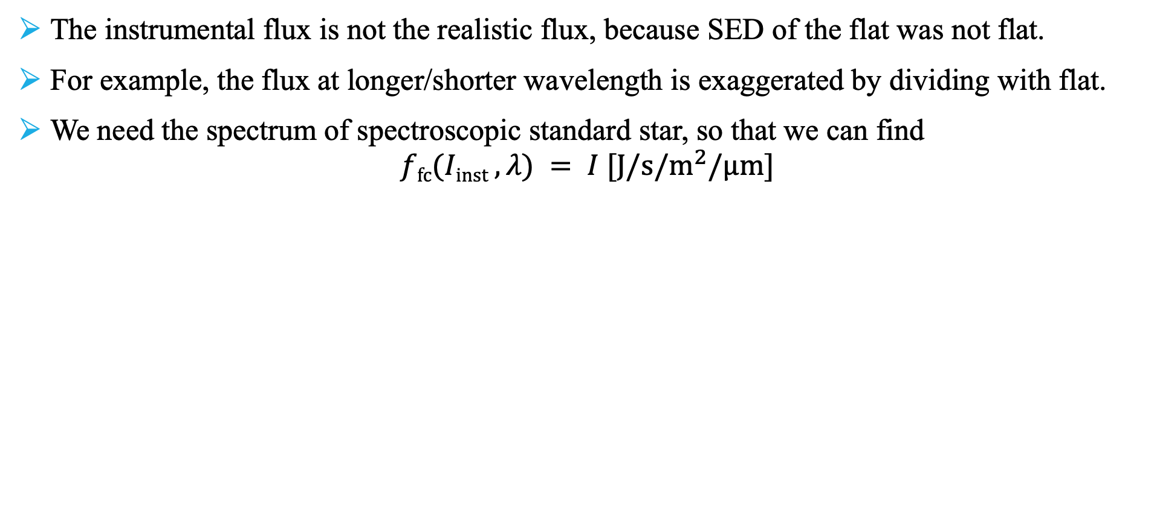
Flux
The instrumental flux is not the realistic flux, because SED of the flat was not flat.
For example, the flux at longer/shorter wavelength is exaggerated by dividing with flat.
We need the spectrum of spectroscopic standard star, so that we can find
$$ffc(Iinst , λ) = I [J/s/m^{2}/μm]$$
Flux calibration:
ideal case
FOCAS Cookbook 1.0.3E

Slide 19
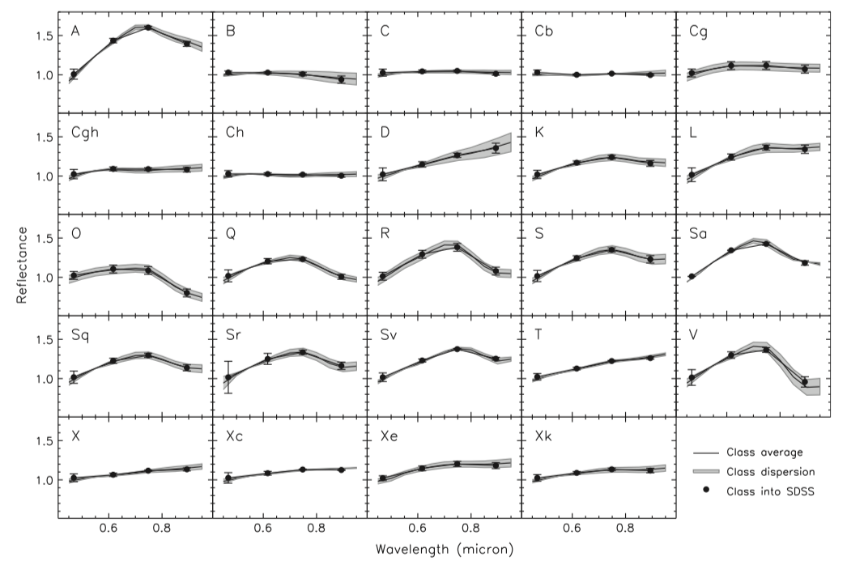
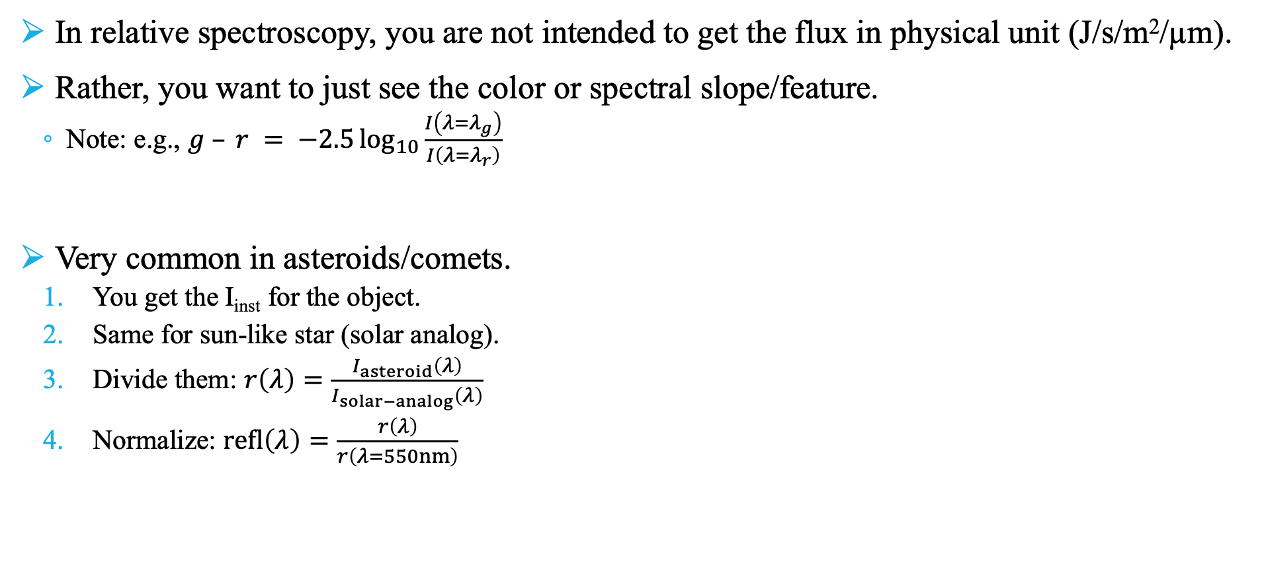
Relative Spectroscopy
In relative spectroscopy, you are not intended to get the flux in physical unit (J/s/m²/µm).
Rather, you want to just see the color or spectral slope/feature.
Note: e.g., $g – r = −2.5\log_{10}{\frac{I\left(λ=λ_{g}\right)}{I\left(λ=λ_{r}\right)}}$
Very common in asteroids/comets.
You get the I_{inst} for the object.
Same for sun-like star (solar analog).
Divide them: $r\left(λ\right)=\frac{I_{asteroid}\left(λ\right)}{I_{solar−analog}\left(λ\right)}$
Normalize: $refl\left(λ\right)=\frac{r\left(λ\right)}{r\left(λ=550nm\right)}$
DeMeo+Carry (2013), Icar, 226, 723

Slide 20
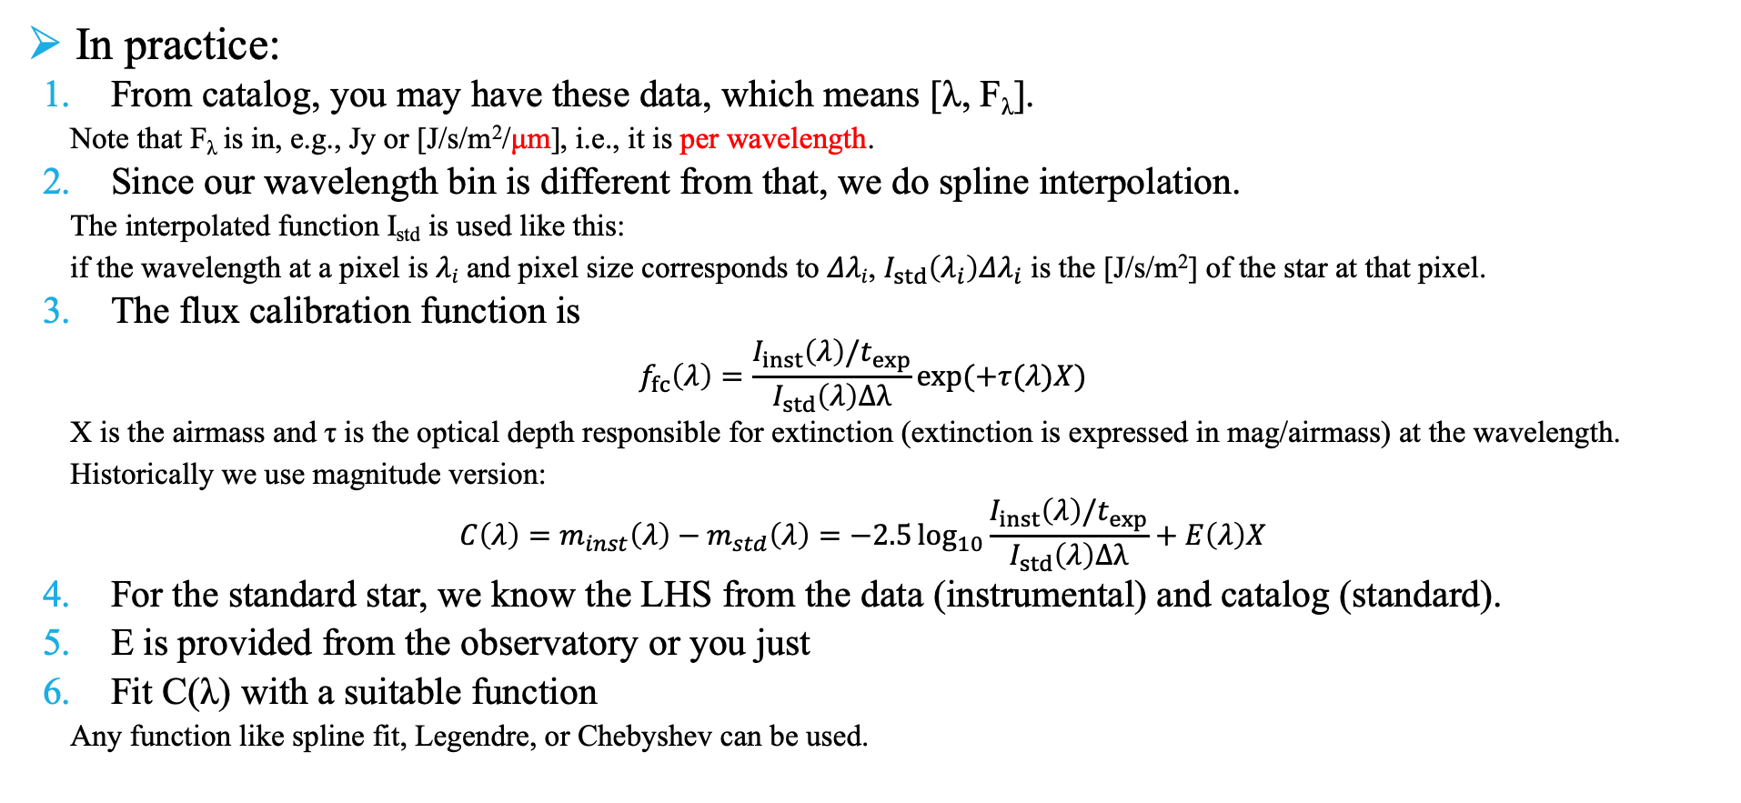
Flux
Spectroscopic standards from ESO: https://www.eso.org/sci/observing/tools/standards/spectra/stanlis.html
[[550, 0.11], [560, 0.13], [570, 0.16], …]
In practice:
From catalog, you may have these data, which means [λ, F_{λ}].
Note that F_{λ} is in, e.g., Jy or [J/s/m²/μm], i.e., it is per wavelength.
Since our wavelength bin is different from that, we do spline interpolation.
The interpolated function I_{std} is used like this:
if the wavelength at a pixel is $λi$ and pixel size corresponds to $Δλi$, $I_{std}\left(λ_{i}\right)Δλ_{i}$ is the [J/s/m²] of the star at that pixel.
The flux calibration function is
$$f_{fc}\left(λ\right)=\frac{I_{inst}\left(λ\right)/t_{exp}}{I_{std}\left(λ\right)Δλ}\exp{(+τ(λ)X)}$$
X is the airmass and τ is the optical depth responsible for extinction (extinction is expressed in mag/airmass) at the wavelength.
Historically we use magnitude version:
$$C\left(λ\right)=m_{inst}\left(λ\right)−m_{std}\left(λ\right)=−2.5\log_{10}{\frac{I_{inst}\left(λ\right){/t}_{exp}}{I_{std}\left(λ\right)Δλ}}+E\left(λ\right)X$$
For the standard star, we know the LHS from the data (instrumental) and catalog (standard).
E is provided from the observatory or you just
Fit C(λ) with a suitable function
Any function like spline fit, Legendre, or Chebyshev can be used.

Slide 21
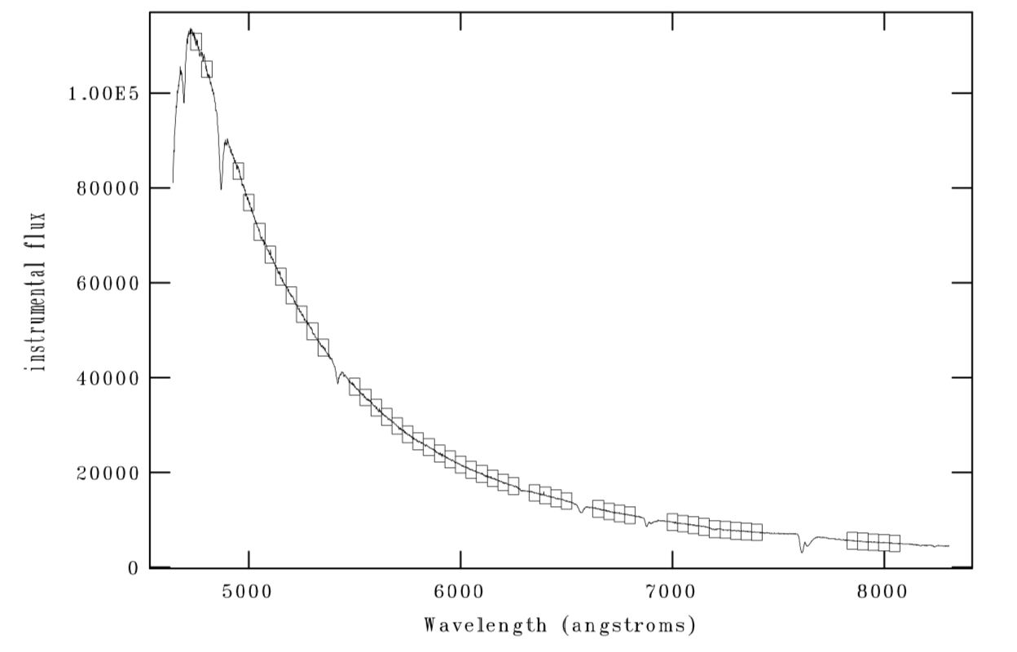
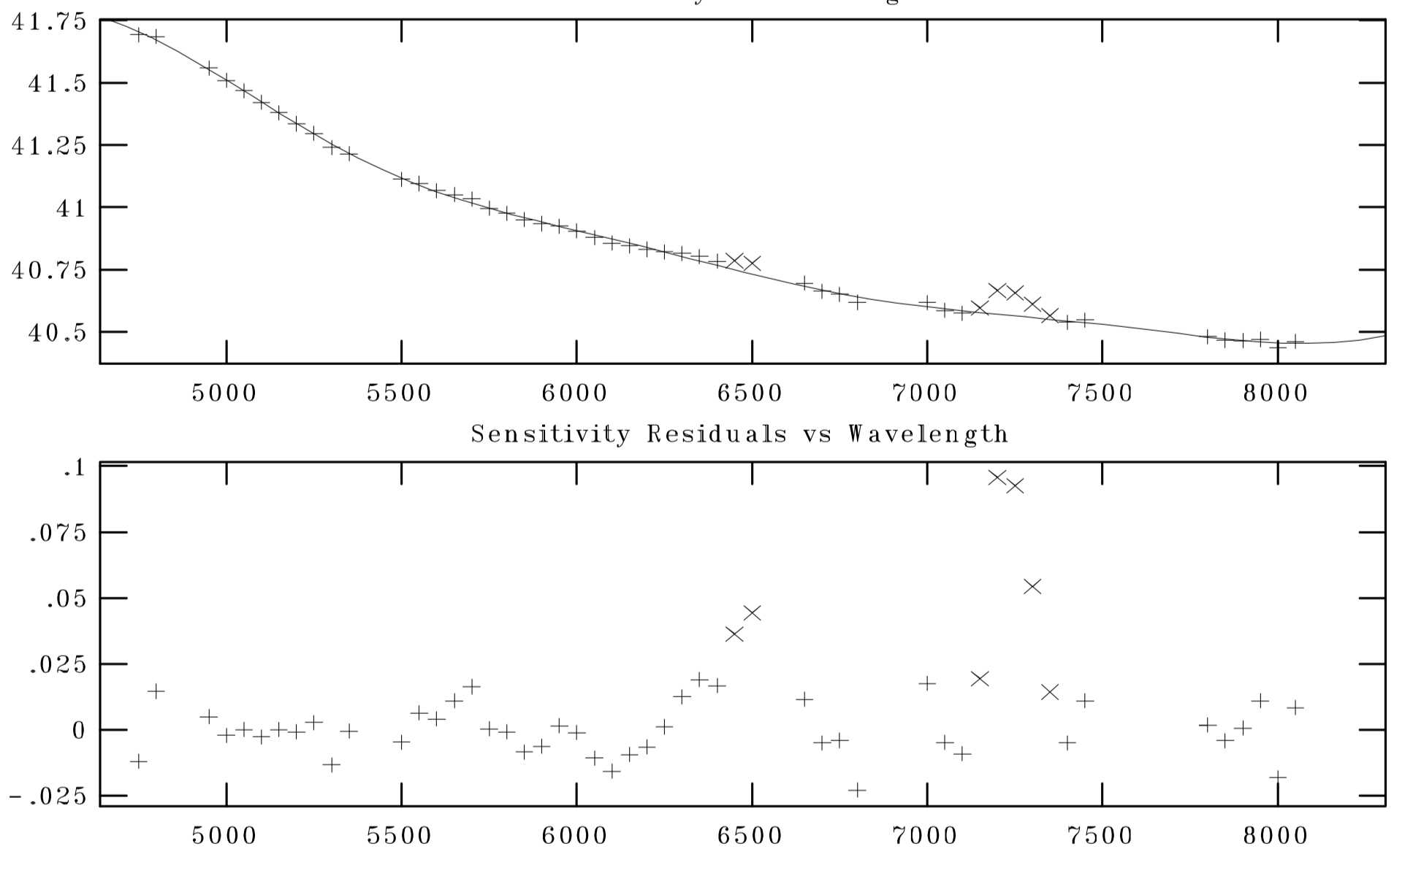
Flux
bumpy residual:
due to instrument's problem
Sometimes catalog is problematic
high absoption region is better to be avoided
The ffc is obtained by fitting the points
(each point = true flux/instrumental).
instrumental (line)
catalog value (real flux) wavelength bin (□)

